Slide 1
Volume One
The Early Years

Slide 2
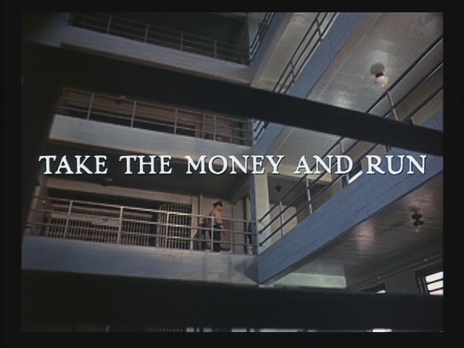

Slide 3
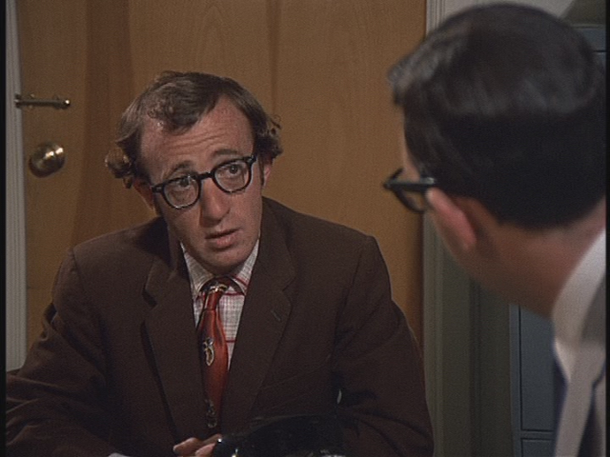
Notes:
Have you any experience in running a high-speed digital electronic computer?
Yes, I have.
Where?
My aunt has one.
And what does your aunt do?
I can't recall.

Slide 4
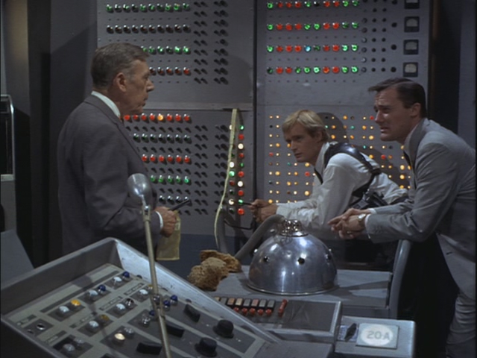

Slide 5
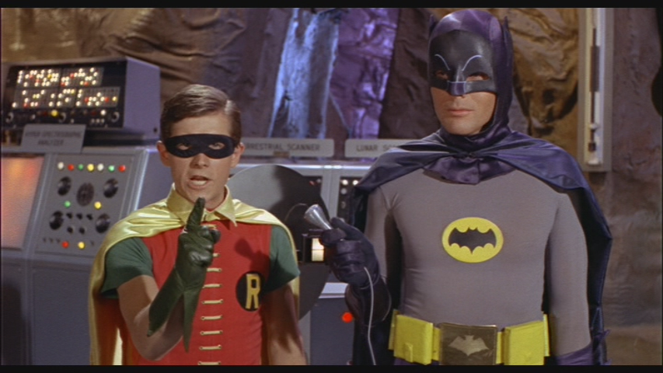

Slide 6
Weaving the Threads
The people who should be the first to recognize the value of an innovation are often the last.
Obsolete technologies fade away slowly.
Sometimes forward, sometimes backward.
The Myth of Inevitability.

Slide 7
Jacquard Loom
Joseph Pierre Charles Jacquard
1801

Slide 8
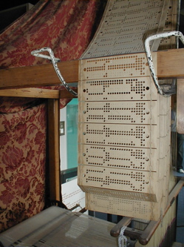

Slide 9
Industrial Sabotage

Slide 10
Hollerith Card Tabulating Machine
1890

Slide 11
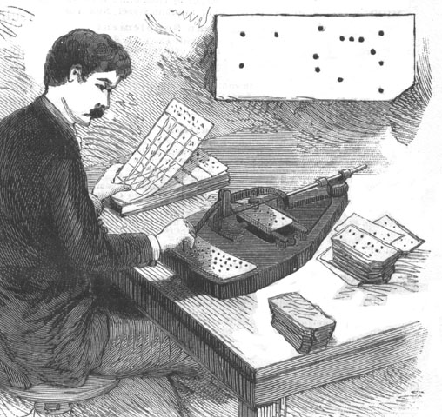

Slide 12
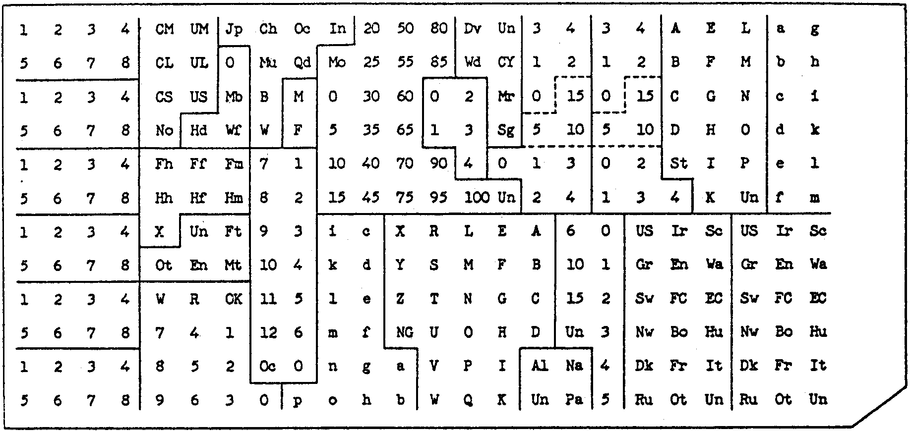

Slide 13
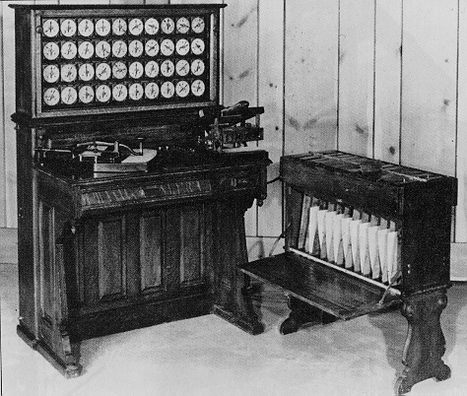

Slide 14
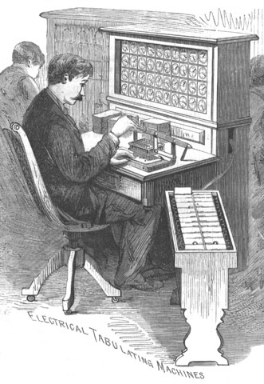

Slide 15
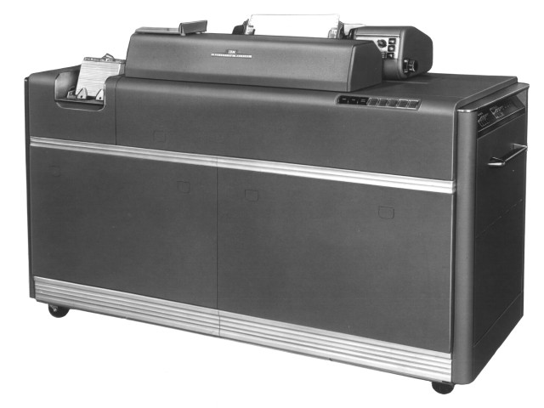

Slide 16
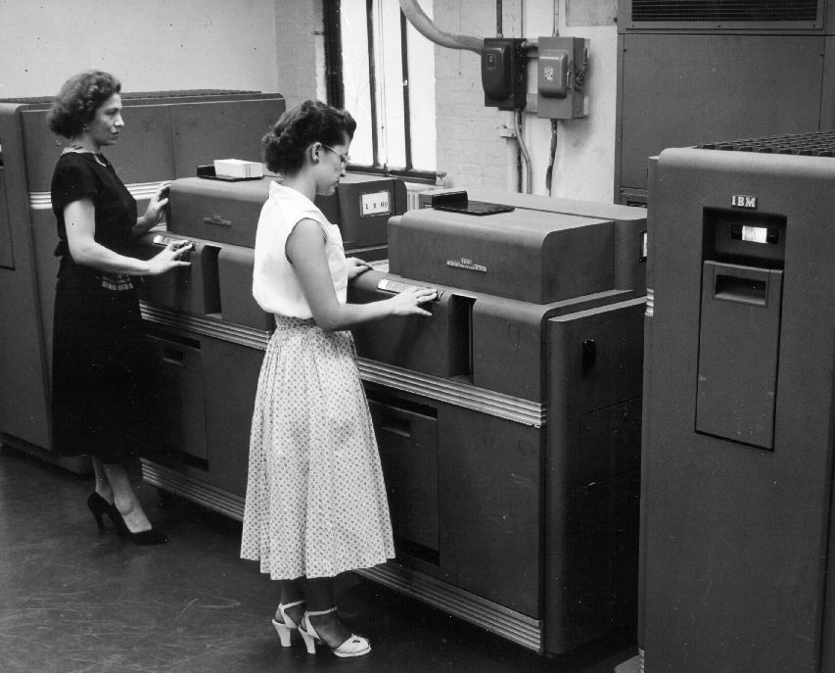

Slide 17
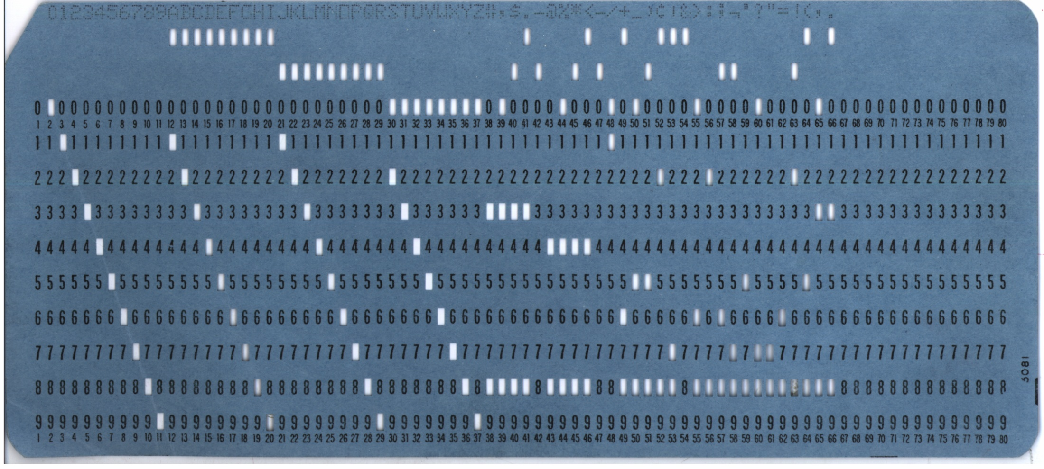

Slide 18
Unit Record Management
Do Not Fold, Spindle,
or Mutilate

Slide 19
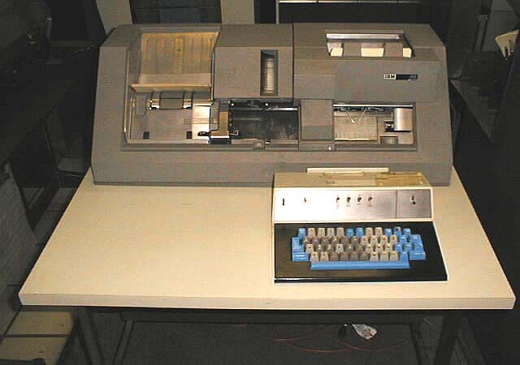

Slide 20
The punched card was
Memory
Storage
Archive
Network
User Interface

Slide 21
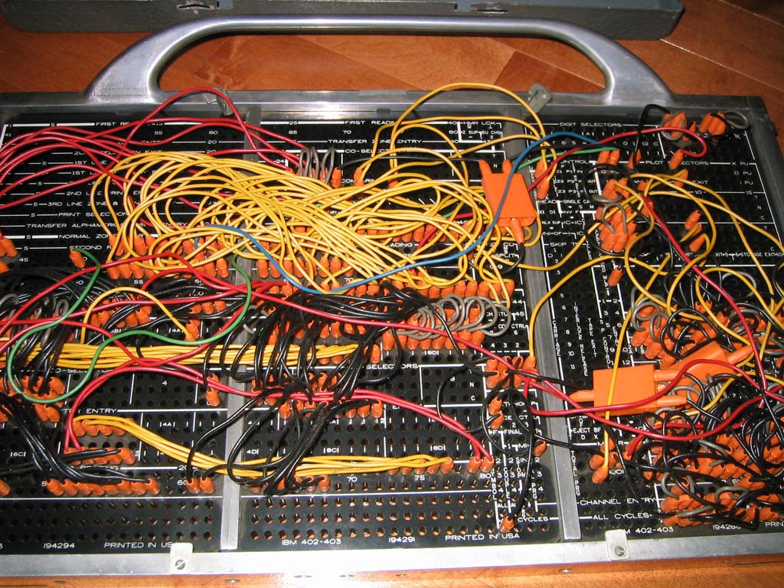

Slide 22
The Rise of the Mainframe
The Stored Program Concept

Slide 23
Assembly Language
BEGIN LDA INTERX
SUB COUNT4
SKZ
JMP ABORT27
JSR CALCKHJ
JMP CONT12
ABORT27 NOP

Slide 24
Enormous architectural variety

Slide 25
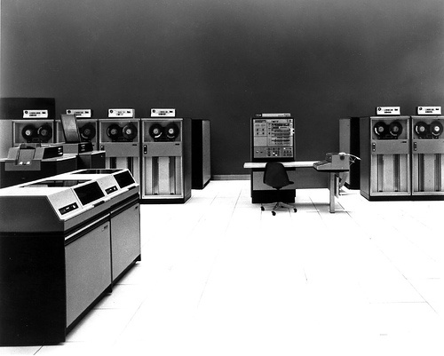

Slide 26
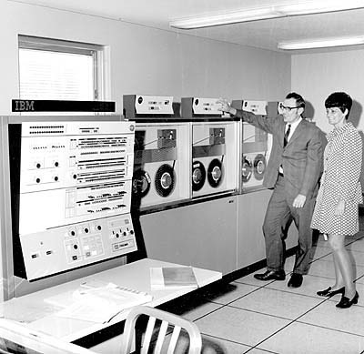

Slide 27
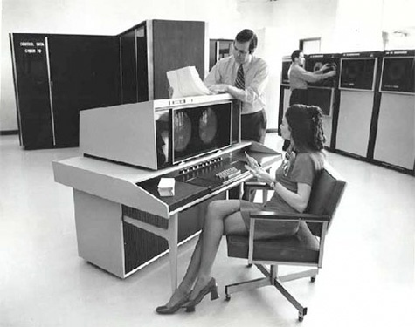

Slide 28
Batch Mode
“Submit.”

Slide 29
Punch cards and mainframes
The analyst writes the specifications and draws the flowcharts.
The programmer codes the program.
The keypuncher punches the program.
The verifier checks the punches.
The operator runs the program.
If there is a bug, call a meeting.

Slide 30
Bugs
Mr Edison, I was informed, had been up the two previous nights discovering a bug in his phonograph.
  Pall Mall Gazette, 1889-03-11

Slide 31
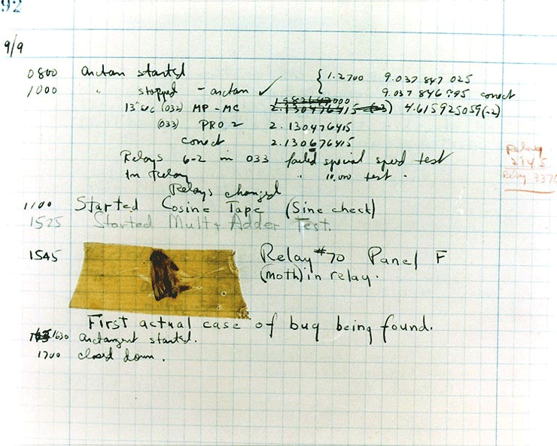
Grace Hopper's Bug

Slide 32
Timesharing

Slide 33
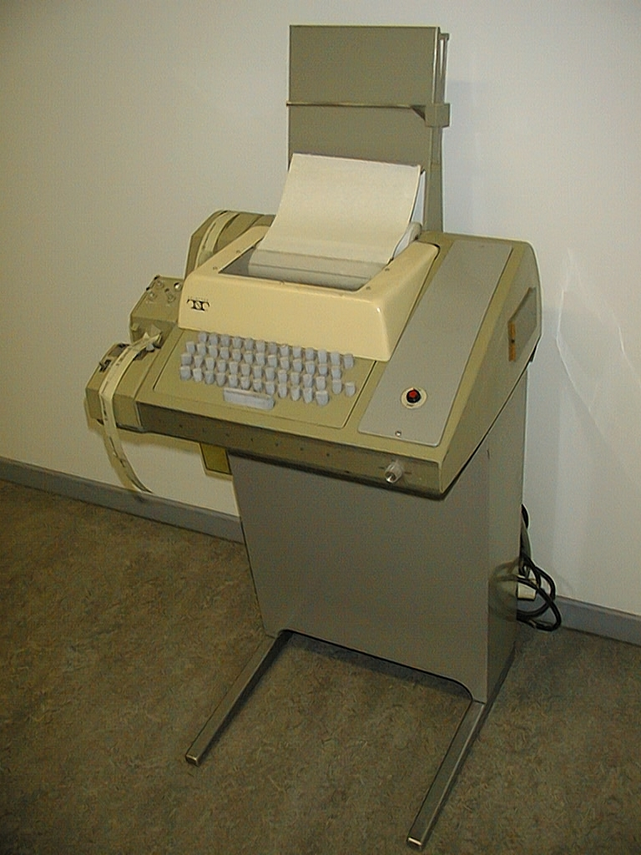

Slide 34
ASCII
|
National Character Sets
|
UNICODE
|
UTF-8

Slide 35
Carriage Return
Linefeed
crlf

Slide 36
Batch v Timesharing

Slide 37
Social Timesharing
File sharing
Email
Distributed computing
Computing as a service
Chat
Blogs
Open Source Development
Games, single and multiplayer
Security

Slide 38
EDIT
|
TECO
|
EMACS
VI

Slide 39
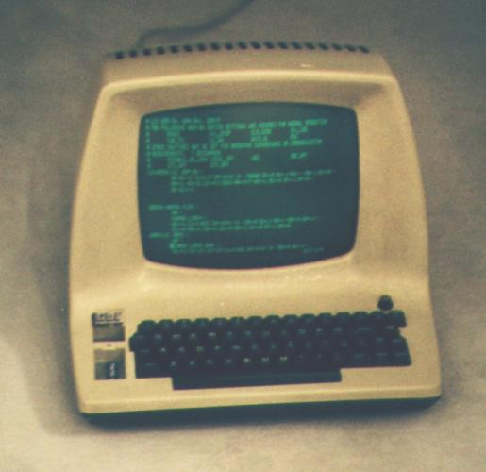

Slide 40
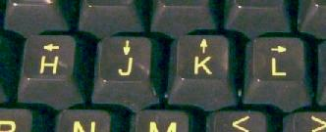

Slide 41
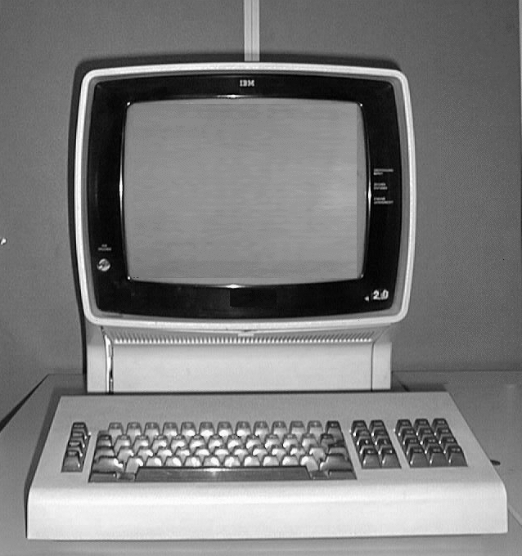
3270

Slide 42
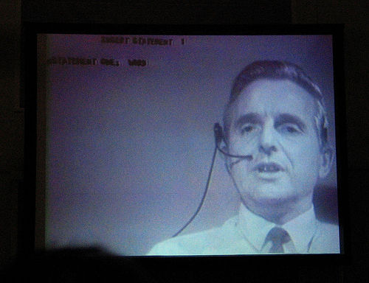
Doug Engelbart
The Mother of All Demos (1968)

Slide 43
Minicomputers

Slide 44
Microcomputers
Intel & Datapoint

Slide 45
8 bit generation
8080, Z80, 6800, 6502

Slide 46
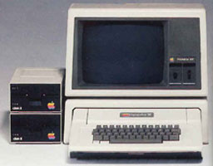
Personal Computing

Slide 47
Z80

Slide 48
16 bit generation
Intel 432, 68000, Z8000, NS32000

Slide 49
Z80 v 8086

Slide 50
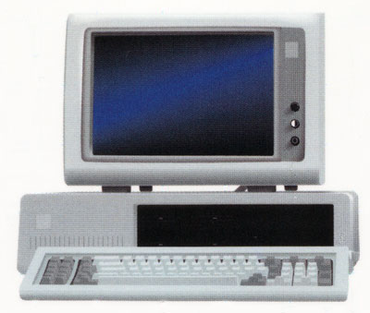
Personal Computing

Slide 51
Z80 v 8086 v 386

Slide 52
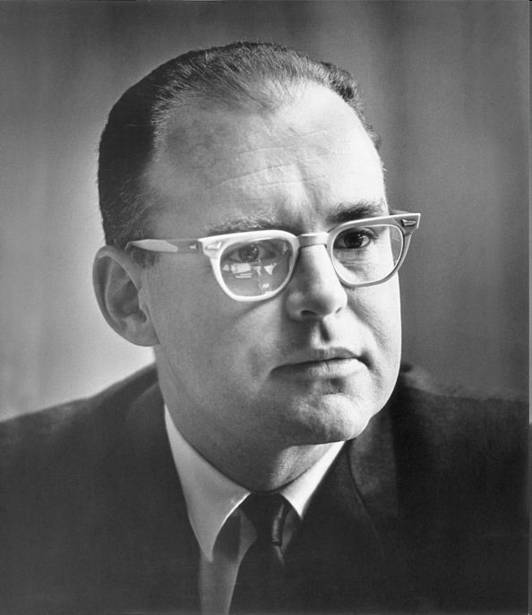
Gordon E. Moore

Slide 53
The complexity for minimum component costs has increased at a rate of roughly a factor of two per year ... Over the longer term, the rate of increase is a bit more uncertain, although there is no reason to believe it will not remain nearly constant for at least 10 years.
1965

Slide 54
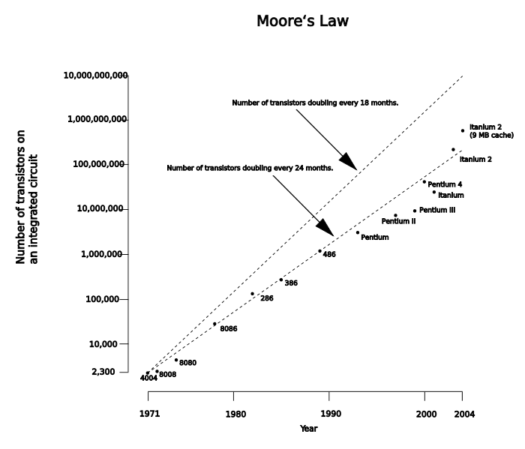

Slide 55
Moore's prediction became a self-fulfilling prophesy.
It cannot hold forever,
but it is still holding now.

Slide 56
An End to Innovation
We have a small set of CPU architectures
  Intel (computers)
  PowerPC (games)
  ARM (mobile)
We have a small set of operating systems
  Unix 70s
  Windows 80s

Slide 57
Automatic Programming
High Level Languages

Slide 58
FORTRAN
SUBROUTINE PROD(DATA, N)
C MULTIPLY THE ELEMENTS OF DATA
C TOGETHER
REAL PRODCT
PRODCT=1;
IF(N)9,9,8
8 DO 9 I=1,N
PRODCT=PRODCT*DATA(I)
9 CONTINUE
RETURN PRODCT
END

Slide 59
COBOL
000100 IDENTIFICATION DIVISION.
000200 PROGRAM-ID. HELLOWORLD.
000300
000400*
000500 ENVIRONMENT DIVISION.
000600 CONFIGURATION SECTION.
000700 SOURCE-COMPUTER. RM-COBOL.
000800 OBJECT-COMPUTER. RM-COBOL.
000900
001000 DATA DIVISION.
001100 FILE SECTION.
001200
100000 PROCEDURE DIVISION.
100100
100200 MAIN-LOGIC SECTION.
100300 BEGIN.
100400 DISPLAY " " LINE 1 POSITION 1 ERASE EOS.
100500 DISPLAY "Hello world!" LINE 15 POSITION 10.
100600 STOP RUN.
100700 MAIN-LOGIC-EXIT.
100800 EXIT.

Slide 60
BASIC
10 REM HELLO WORLD GAME
20 PRINT "WHAT IS YOUR NAME?"
30 INPUT N$
40 PRINT "HELLO, " & N$ & "!"
50 IF N$="WORLD" THEN 80
60 PRINT "GUESS AGAIN."
70 GOTO 20
80 STOP

Slide 61
BASIC
Business BASIC
Microsoft BASIC
Visual Basic

Slide 62
ALGOL 60
The best design-by-committee in the history of programming languages.

Slide 63
Structured Programming
GOTO considered harmful

Slide 64
FORTRAN
COBOL
ALGOL
PL/I
CPL
ALGOL 68

Slide 65
CPL
ALGOL
Pascal
BCPL

Slide 66
FORTRAN
BCPL
Pascal
B
C

Slide 67
Assembly Language v
High Level Language
Debate

Slide 68
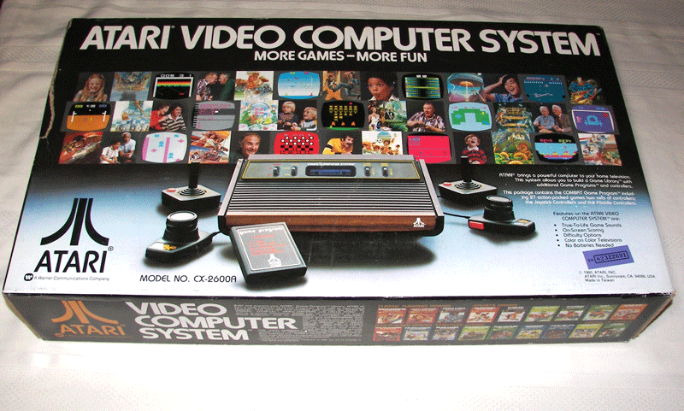

Slide 69
Atari 2600 VCS
6507 CPU
  Registers: A X Y S F (8 bit) PC (16 bit)
There is no software or firmware in the console.
A ROM cartridge can hold 4K or 8K.
Console has 128 bytes of RAM.
  That has to hold all of the game’s dynamic state, including the subroutine stack.

Slide 70
ALGOL
Simula
Smalltalk

Slide 71
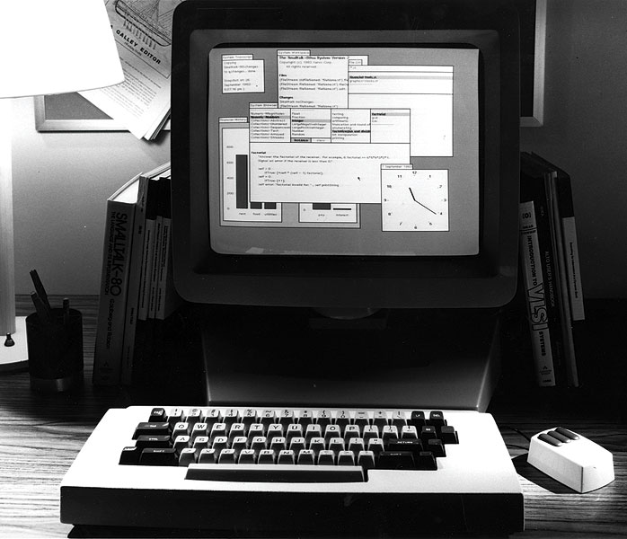

Slide 72
Smalltalk
result := a > b
ifTrue:[ 'greater' ]
ifFalse:[ 'less or equal' ]

Slide 73
C
Smalltalk
Objective C
C++
Eiffel
Java
C#

Slide 74
Object Oriented Programming
1967 Simula
1971 Kay begins Smalltalk
1980 Smalltalk released
1985 C++ Programming Language
1995 The Java Programming Language

Slide 75
Leaps
Plugboards
Symbolic Assembly Language
High Level Languages
Structured Programming
Object Oriented Programming

Slide 76
Smalltalk
Self

Slide 77
The Actor Model
What if “send a message” meant “send a message”.

Slide 78
LISP
The Actor Model
Scheme

Slide 79
The Actor Model
Java
Joule
E
The Object Capability Model

Slide 80
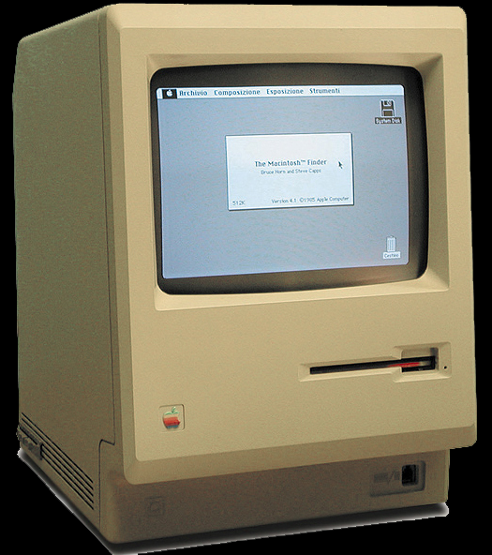

Slide 81
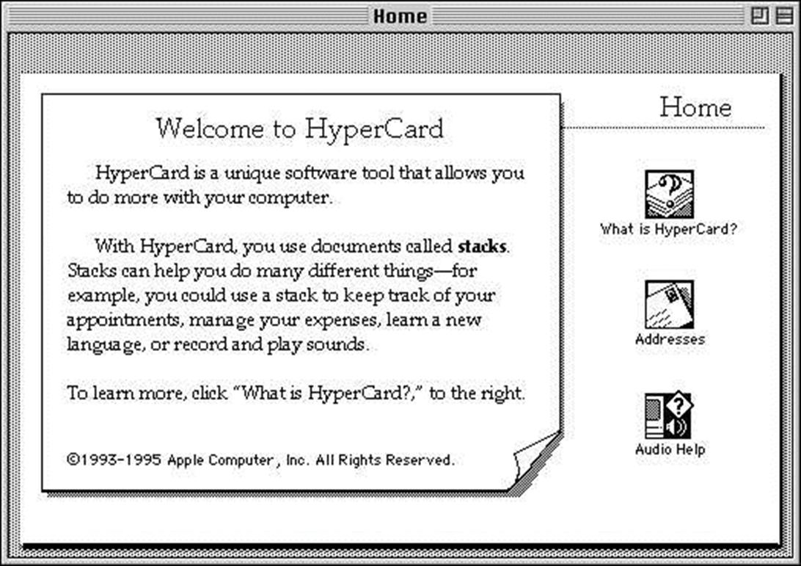

Slide 82
HyperCard types
Stack: contains backgrounds and cards
Background: an image and buttons and fields
Card: a background and buttons and fields
Button: text and/or image
Field: text

Slide 83
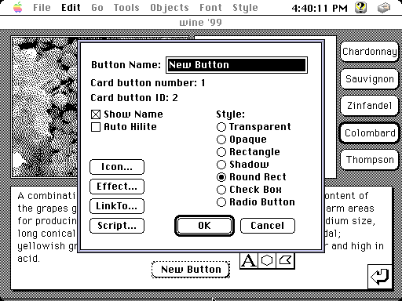

Slide 84
HyperTalk
on mouseUp
put "100,100" into pos
repeat with x = 1 to the ¬
number of card buttons
set the location of card ¬
button x to pos
add 15 to item 1 of pos
end repeat
end mouseUp

Slide 85
HyperCard
Stacks of cards containing images, buttons, and text fields.
Didn't anticipate color.
Didn't anticipate text links.
Didn't anticipate networking.
A decade later, cards would become pages.

Slide 86
Engelbart’s NLS
Nelson’s Xanadu
HyperCard
WWW

Slide 87
WWW
Mosaic
Spyglass
Netscape
Internet Explorer

Slide 88
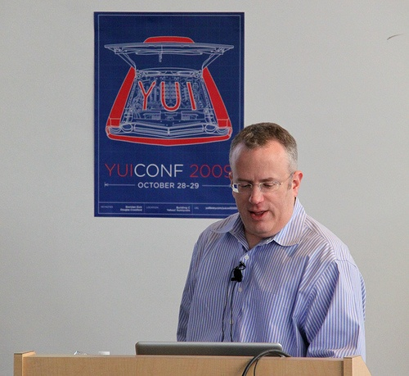

Slide 89
Java
Scheme
Self
JavaScript

Slide 90
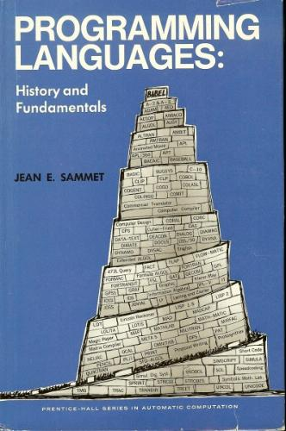
Babel
Jean Sammet (1969)
It described > 100 languages
We are now in another period of language design innovation
Haskell, Erlang, Scala…

Slide 91
Next time:
Chapter 2
And then there was JavaScript.

